Slide 1
An Exploratory Data Analysis
of the Credit Union Member Dataset
Xinzhe Deng, Han Li, Lan Li and Te Lin
IS 590 Predictive Analysis in Finance
Fal 2018

Slide 2
Process of EDA
An iterative cycle of:
Generate questions about the data.
Search for answers by visualising, transforming, and modelling the data.
Use what we learn to refine your questions and/or generate new questions.
(Wickham & Grolemund)

Slide 3
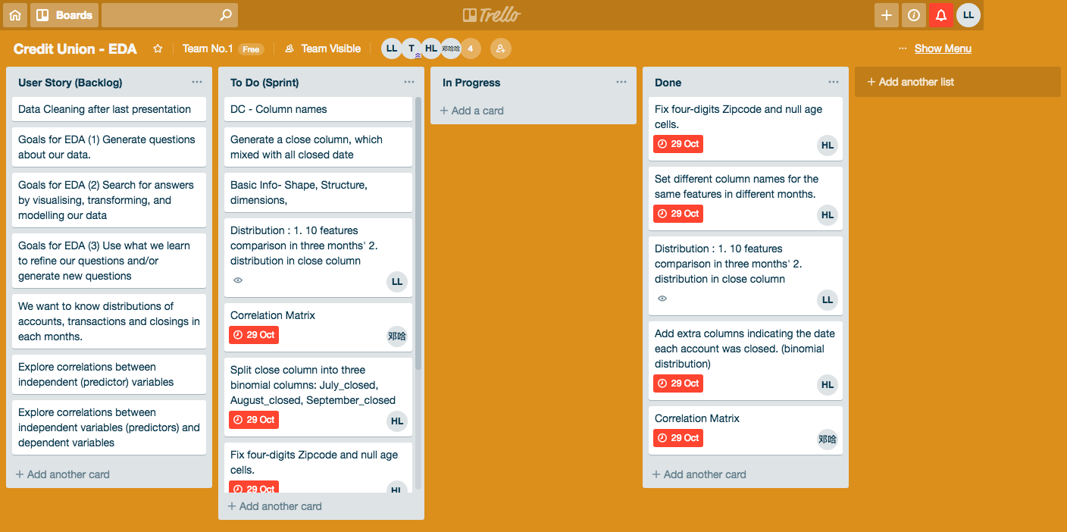

Slide 4
Goal
Find the correlation between:
when the customer closes the accounts and
the features.

Slide 5
The Dataset at a Glance
> str(open_user)
'data.frame': 34326 obs. of 48 variables:
$ Member_ID : int 1 3 4 5 6 7 8 9 10 12 ...
$ Age : num 73 24 76 69 69 63 41 5 29 31 ...
$ EarliestMemAcctDate: Date, format: "1998-09-08" "2016-01-08" "1987-07-02" "2011-10-18" ...
$ ClosedDate : Date, format: NA NA "2018-08-06" NA ...
$ ZipCode_Validated : num 85051 52302 61912 52802 52722 ...
$ July_Bal : int 20180731 20180731 20180731 20180731 20180731 20180731 20180731 20180731 20180731 20180731 ...
$ July.Trans : int 5 NA 2 103 32 NA NA NA 24 2 ...
$ Visa.Jul : num NA NA NA 2033 NA ...
$ Mortgage.Jul : num NA NA NA NA 18059 ...
$ Home.Equity.Jul : num NA NA NA NA NA NA NA NA NA NA ...
$ Other.Loan.Jul : num NA NA NA 6378 NA ...
$ Vehicle.Jul : num NA NA NA 4693 NA ...
$ Checking.Jul : num 2233.6 NA NA -53.5 574.6 ...
$ Savings.Jul : num 182.6 5 290.24 22 5.77 ...
$ CD.Jul : num NA NA NA NA NA NA NA NA NA NA ...
$ IRA.Jul : num NA NA NA NA NA NA NA NA NA NA ...
$ Money.Market.Jul : num NA NA NA NA NA NA NA NA NA NA ...
( account informations in August and September omitted…)
$ Money.Market.Sept : num NA NA NA NA NA NA NA NA NA NA ...
$ Jul.closed : num 0 0 0 0 0 0 0 0 0 0 ...
$ Aug.closed : num 0 0 1 0 0 0 1 0 0 0 ...
$ Sept.closed : num 0 0 0 0 0 0 0 0 0 0 ...
$ Oct.closed : num 0 0 0 0 0 0 0 0 0 0 ...
$ Open : num 1 1 0 1 1 1 0 1 1 1 ...
$ CloseDate_node : Date, format: "2018-10-29" "2018-10-29" "2018-08-06" "2018-10-29" ...
$ Active_period : num 7356 1025 11358 2568 5687 ...
34326 observations of
48 variables:
The rests:
Independent Variables
(Predictors)
(33 of them are numeric)
Dependent variables

Slide 6
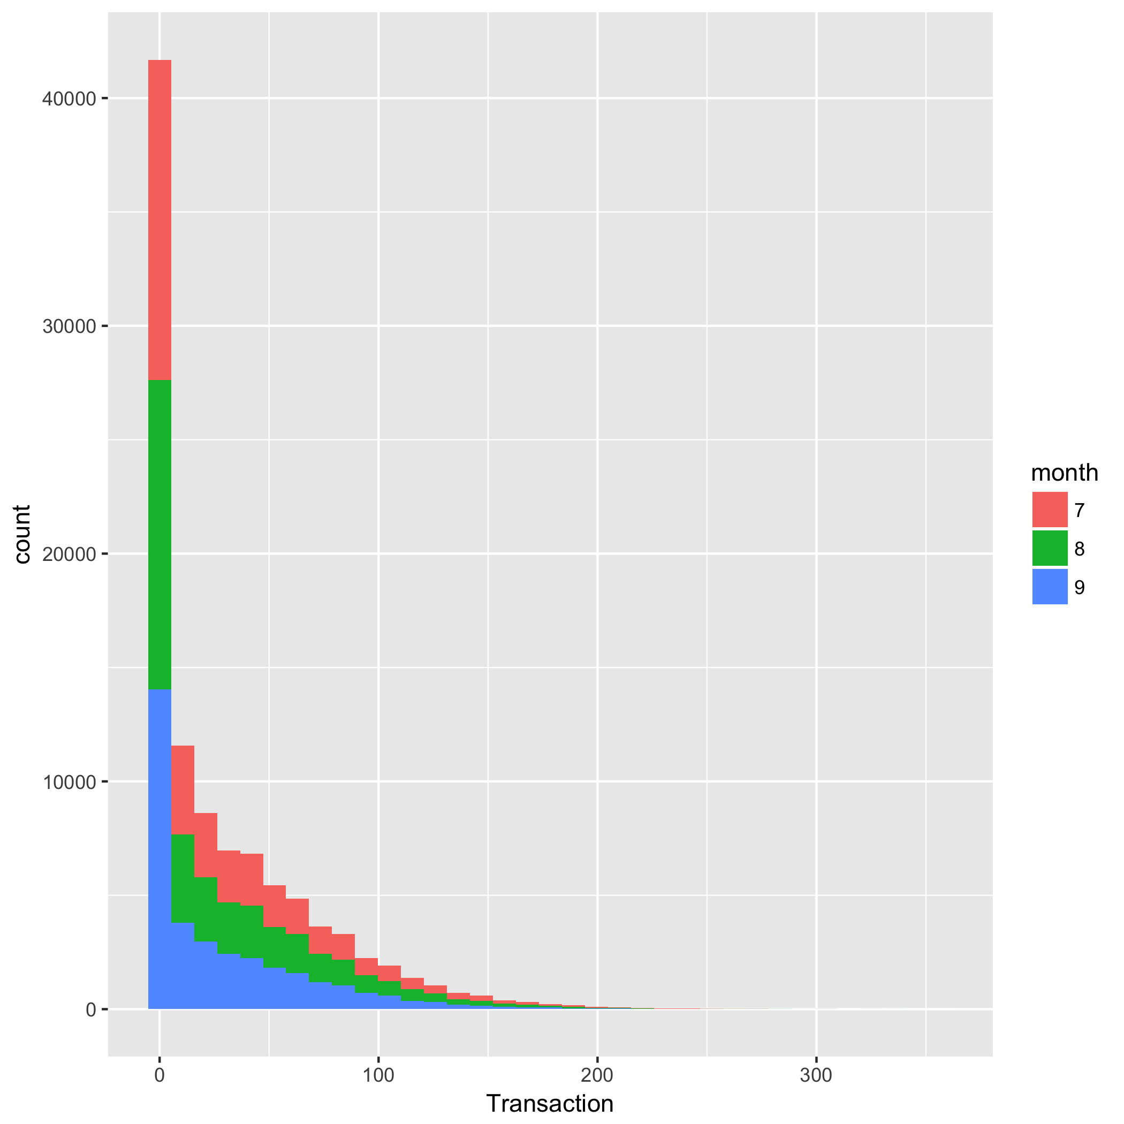
Frequency Plot:
Transactions

Slide 7
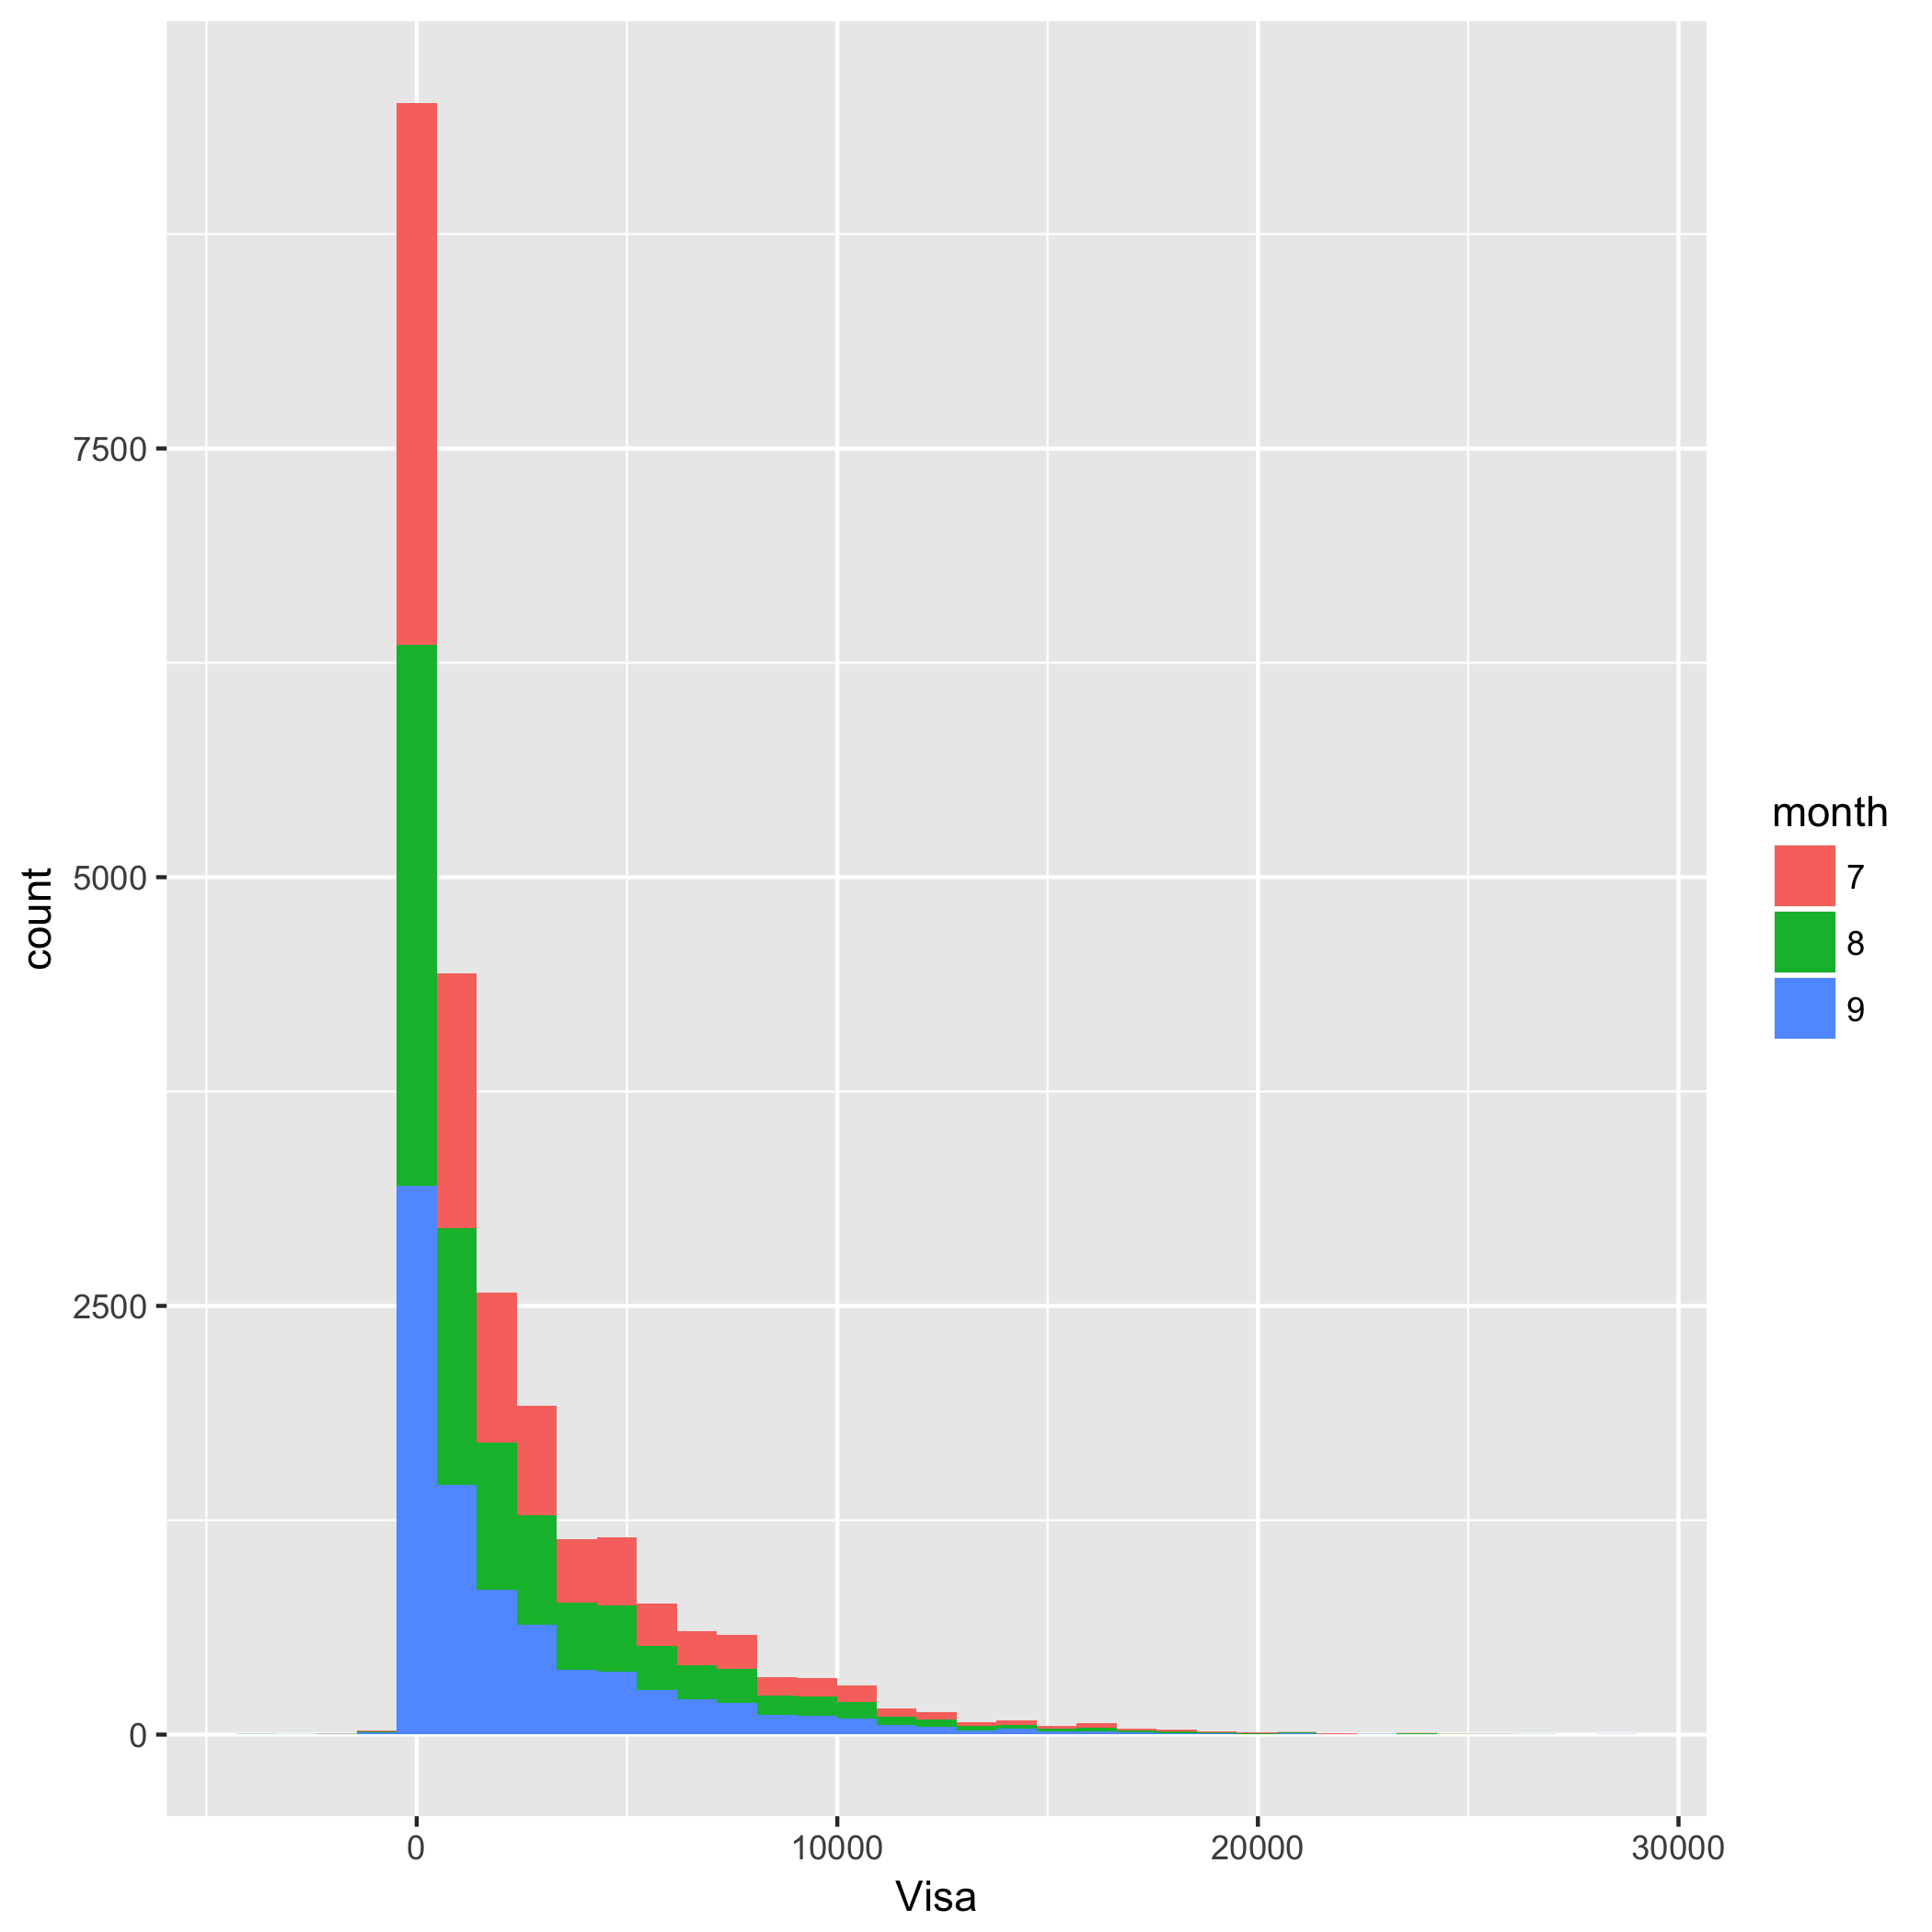
Frequency Plot:
Visa

Slide 8
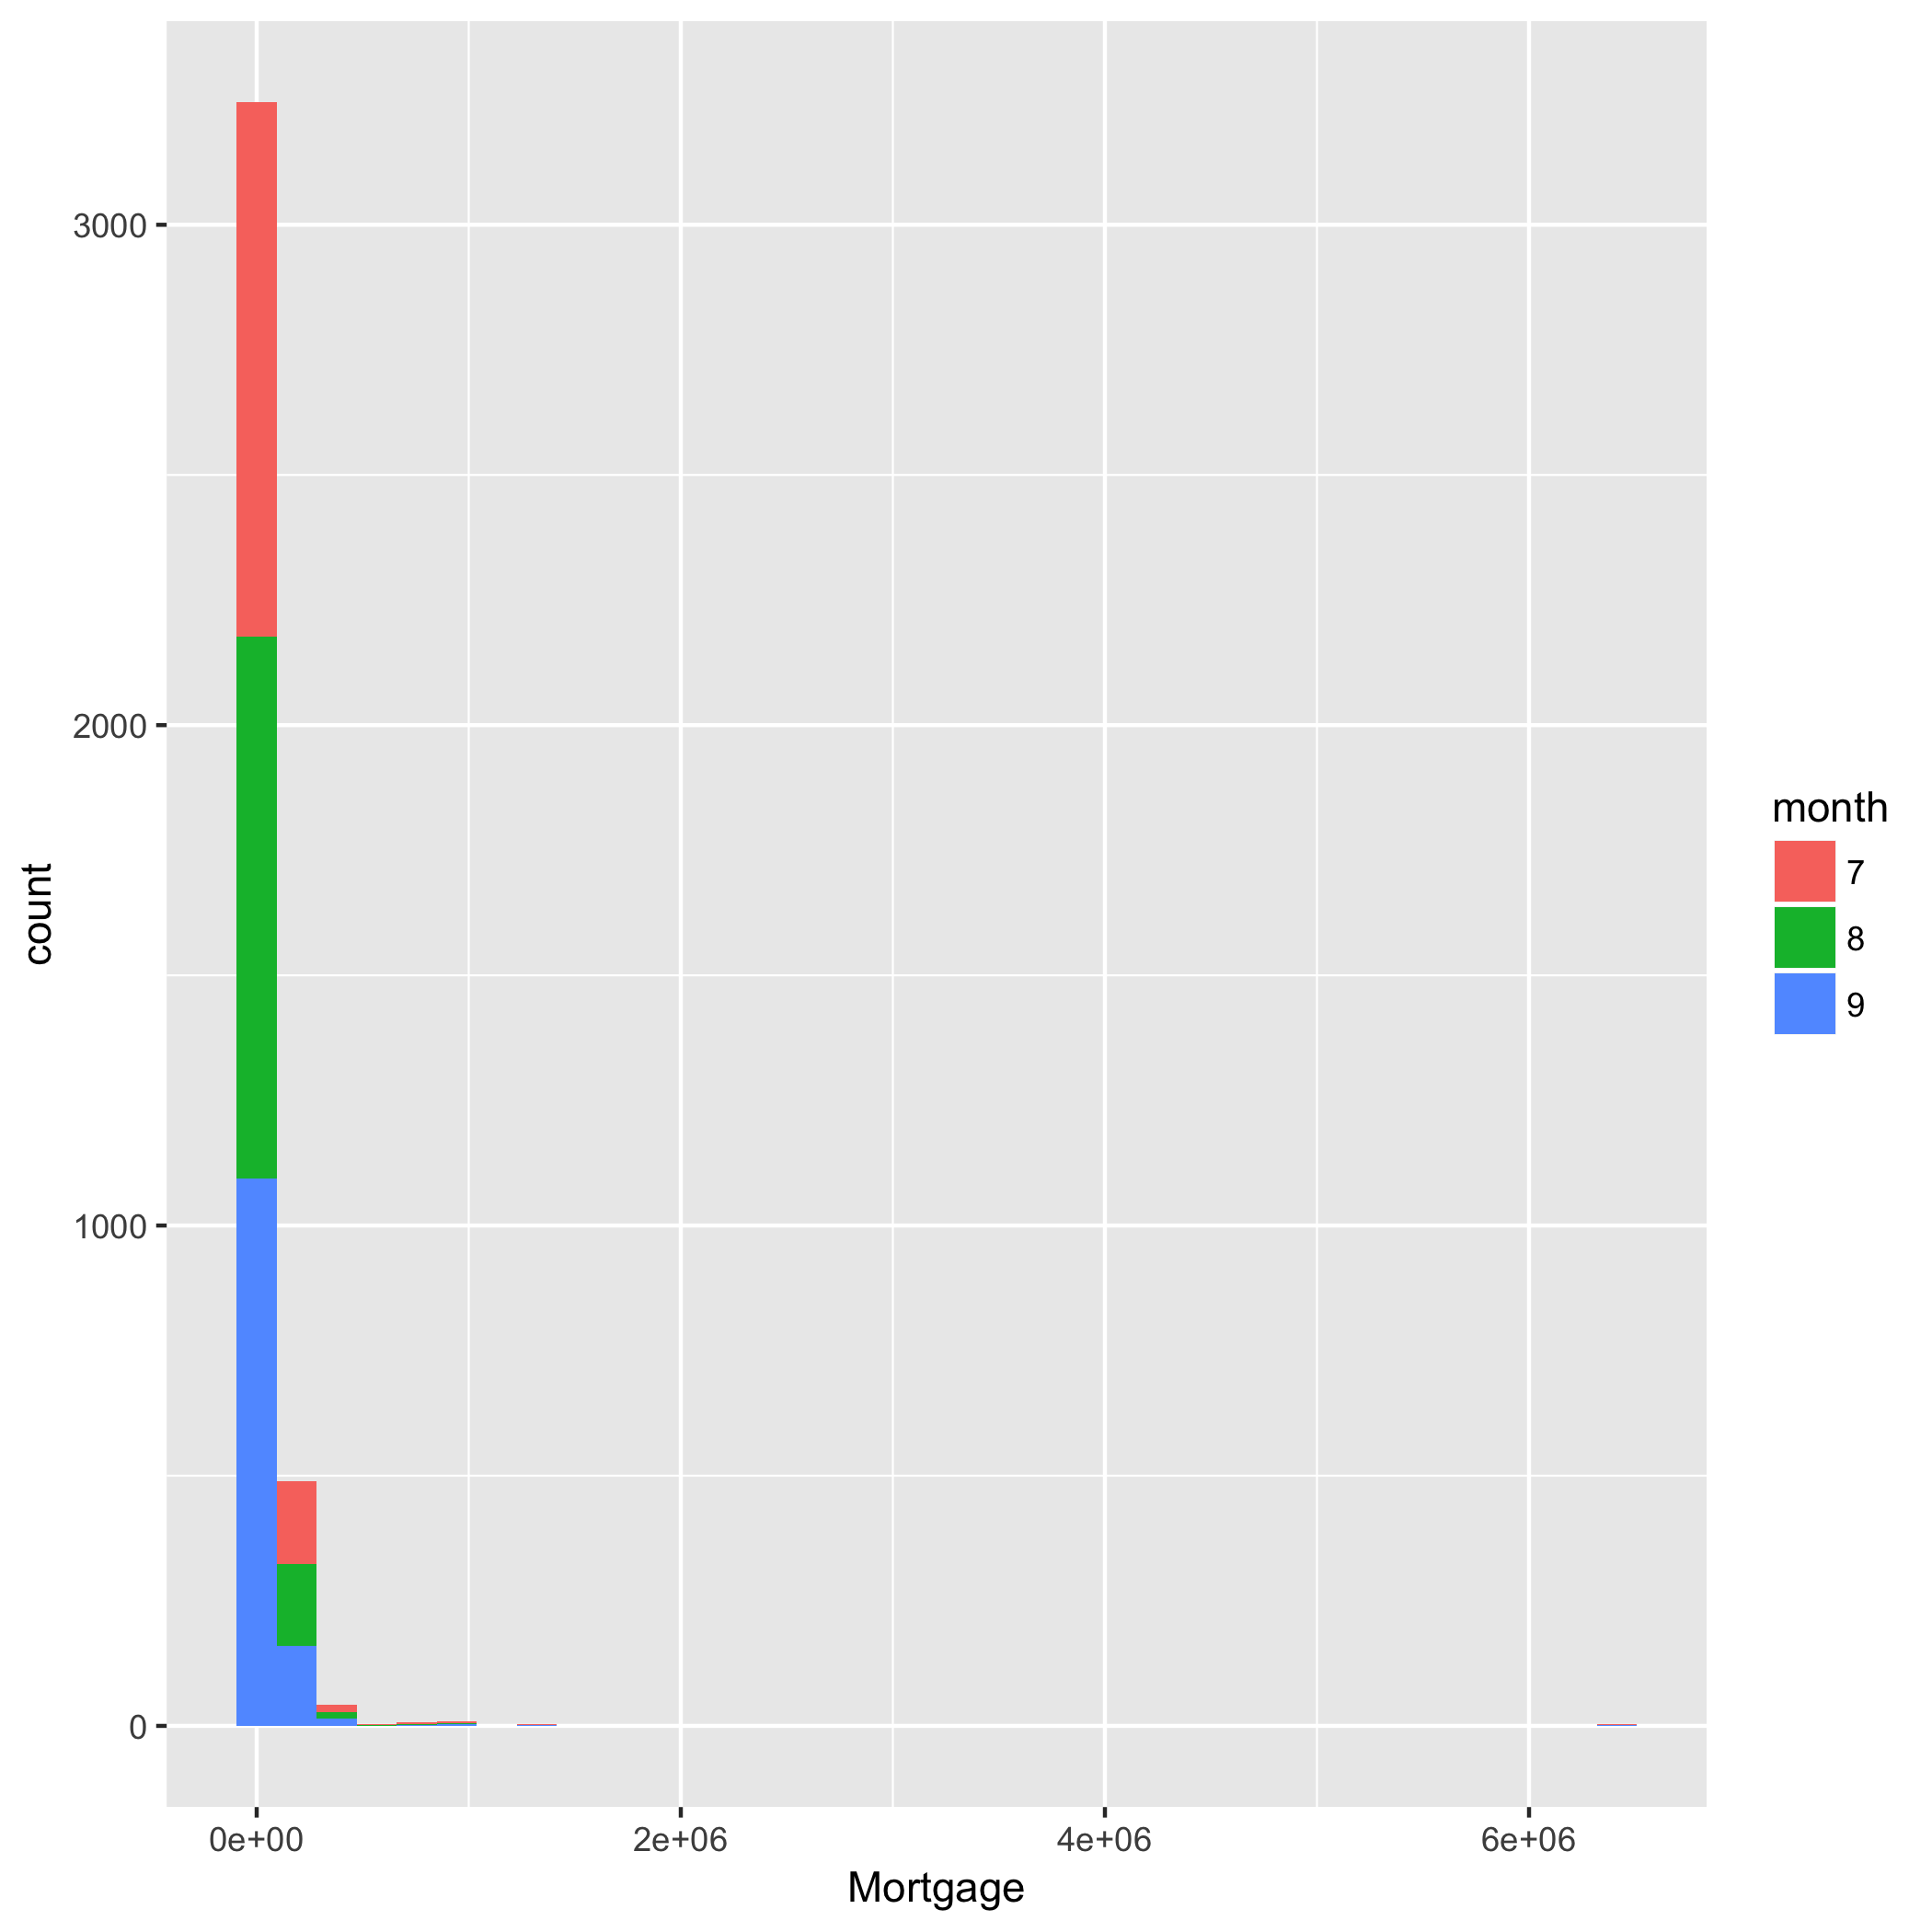
Frequency Plot:
Mortgage

Slide 9
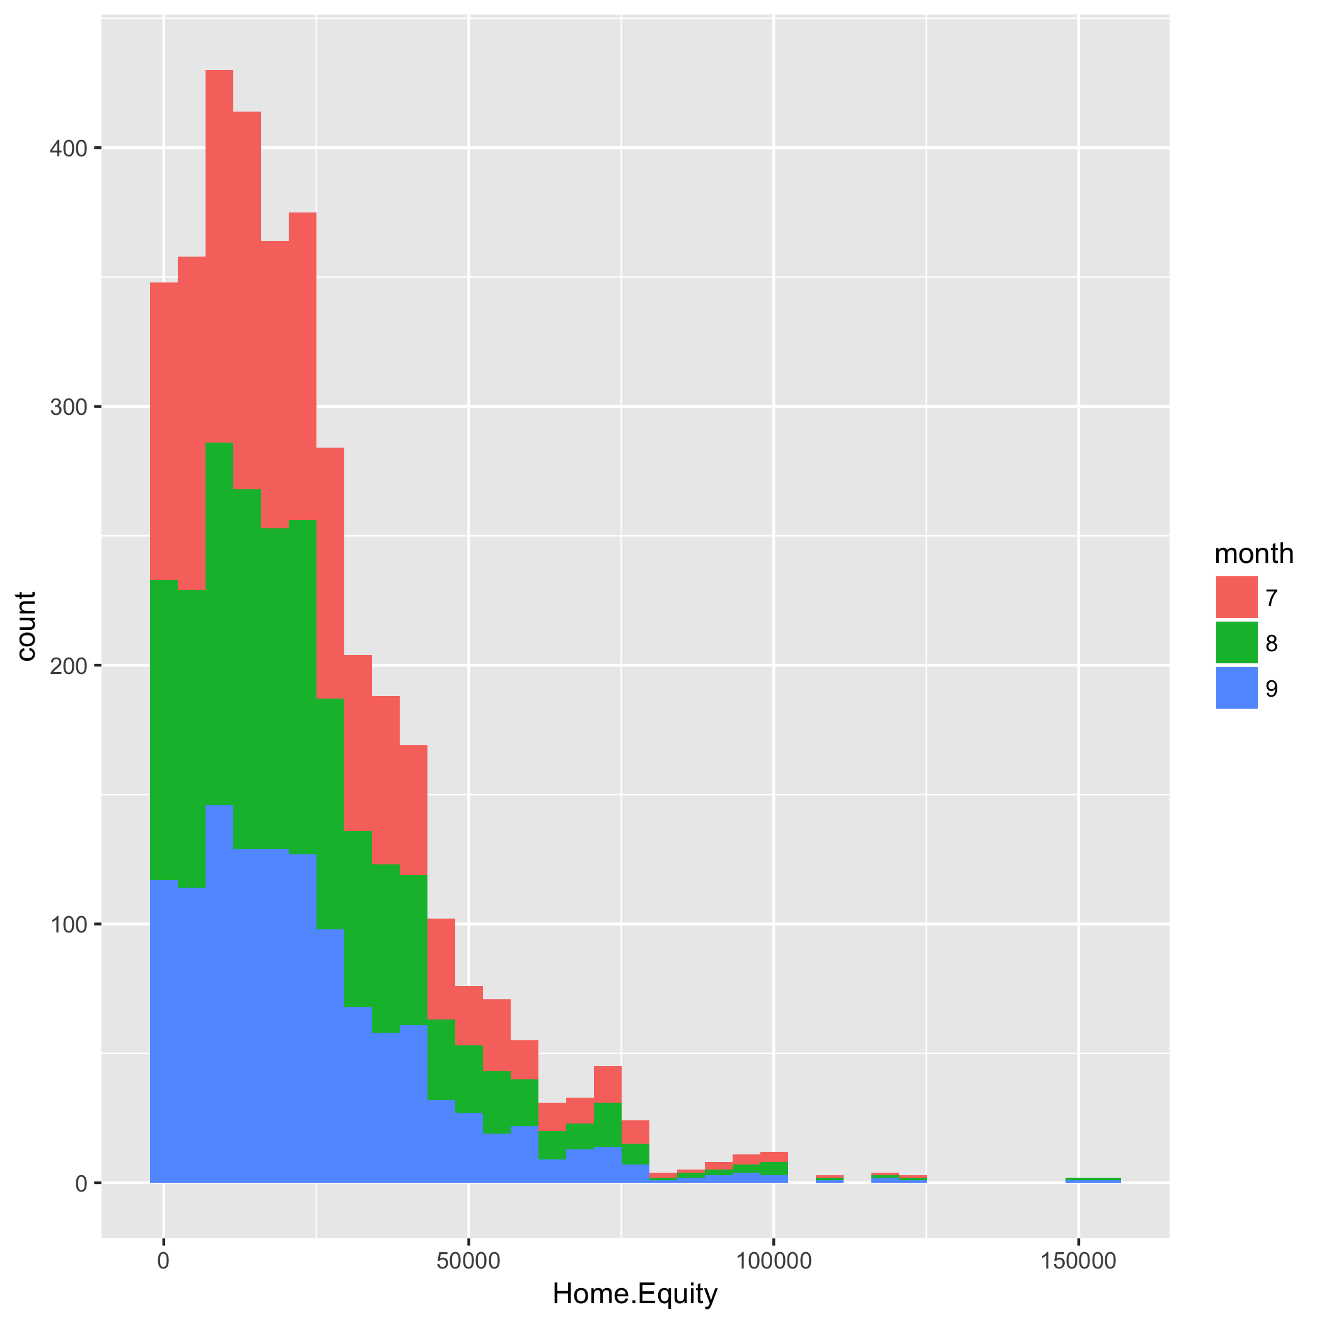
Frequency Plot:
Home Equity

Slide 10
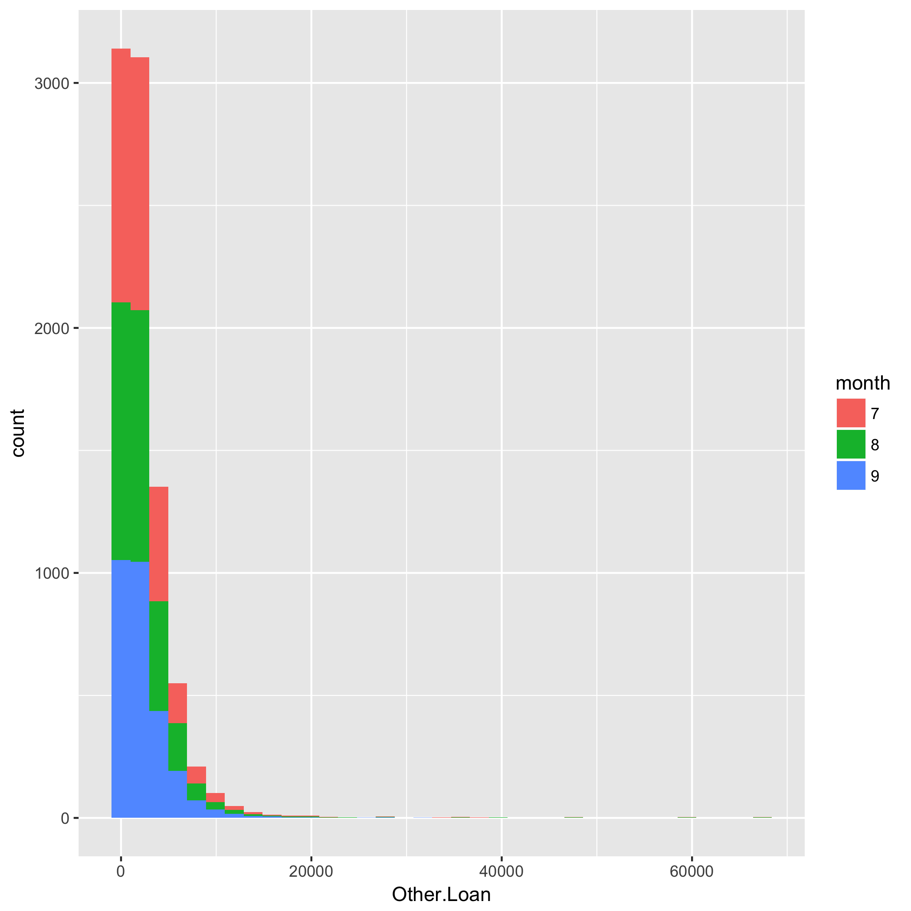
Frequency Plot:
Other Loan

Slide 11
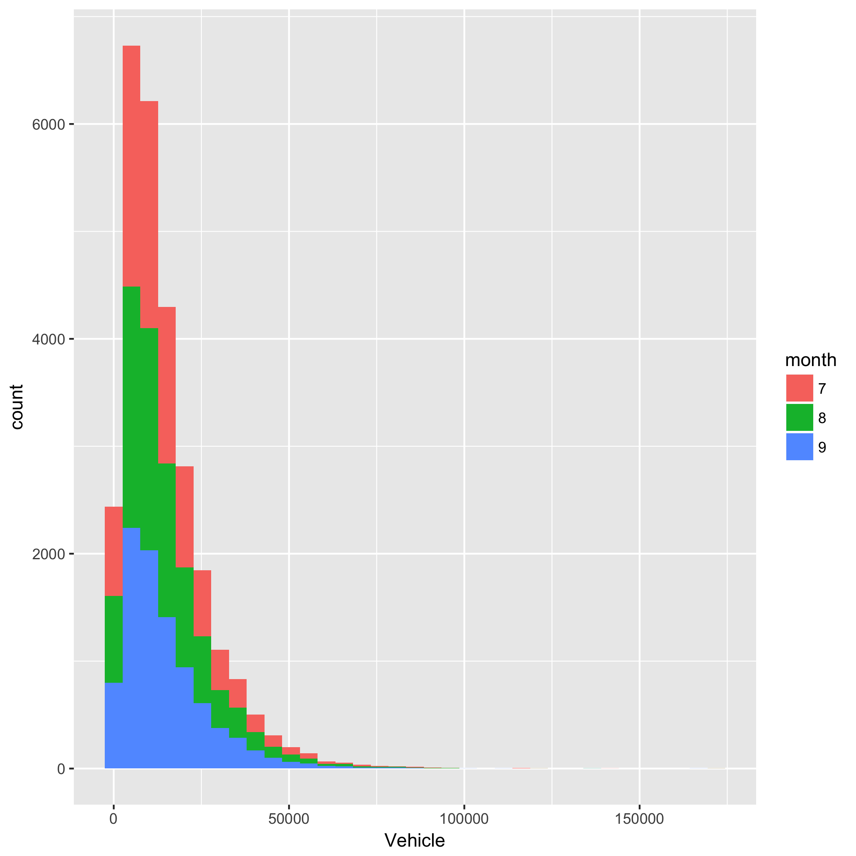
Frequency Plot:
Vehicle Loans

Slide 12
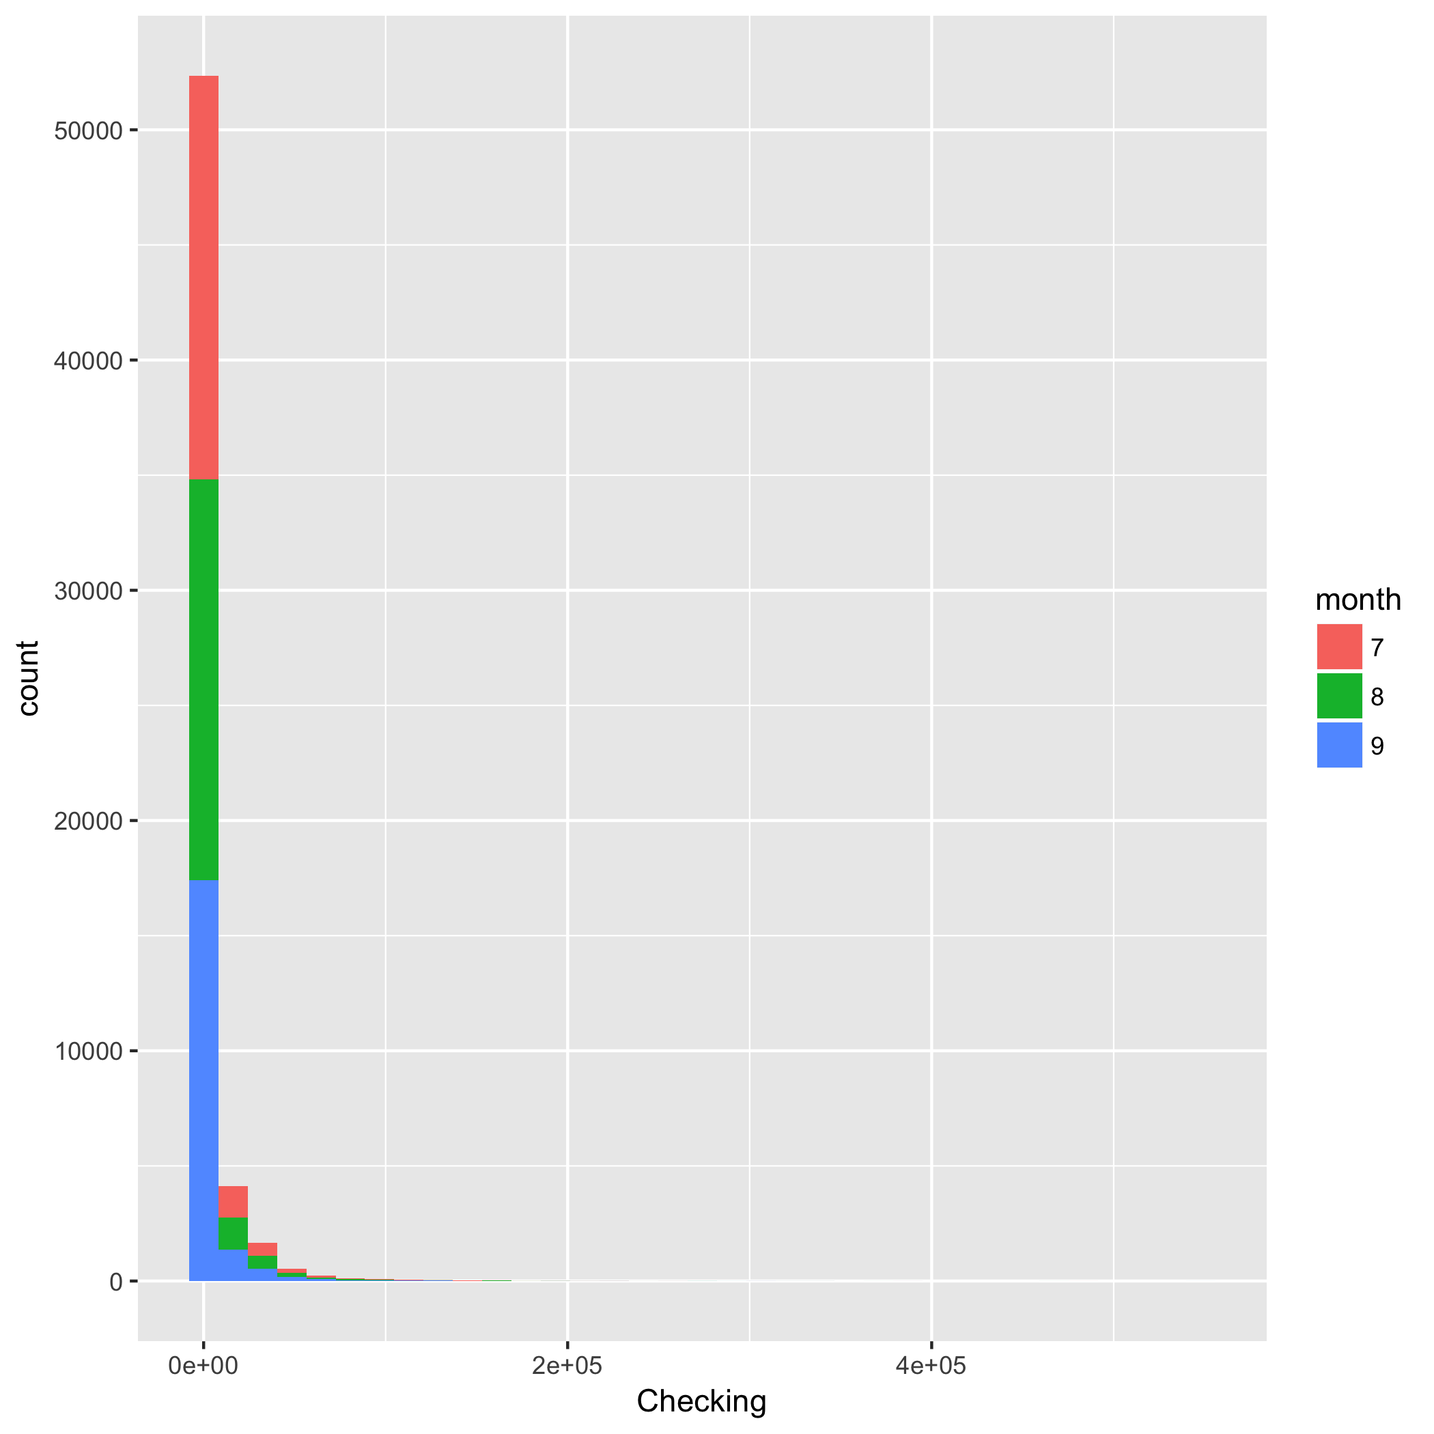
Frequency Plot:
Checking Account

Slide 13
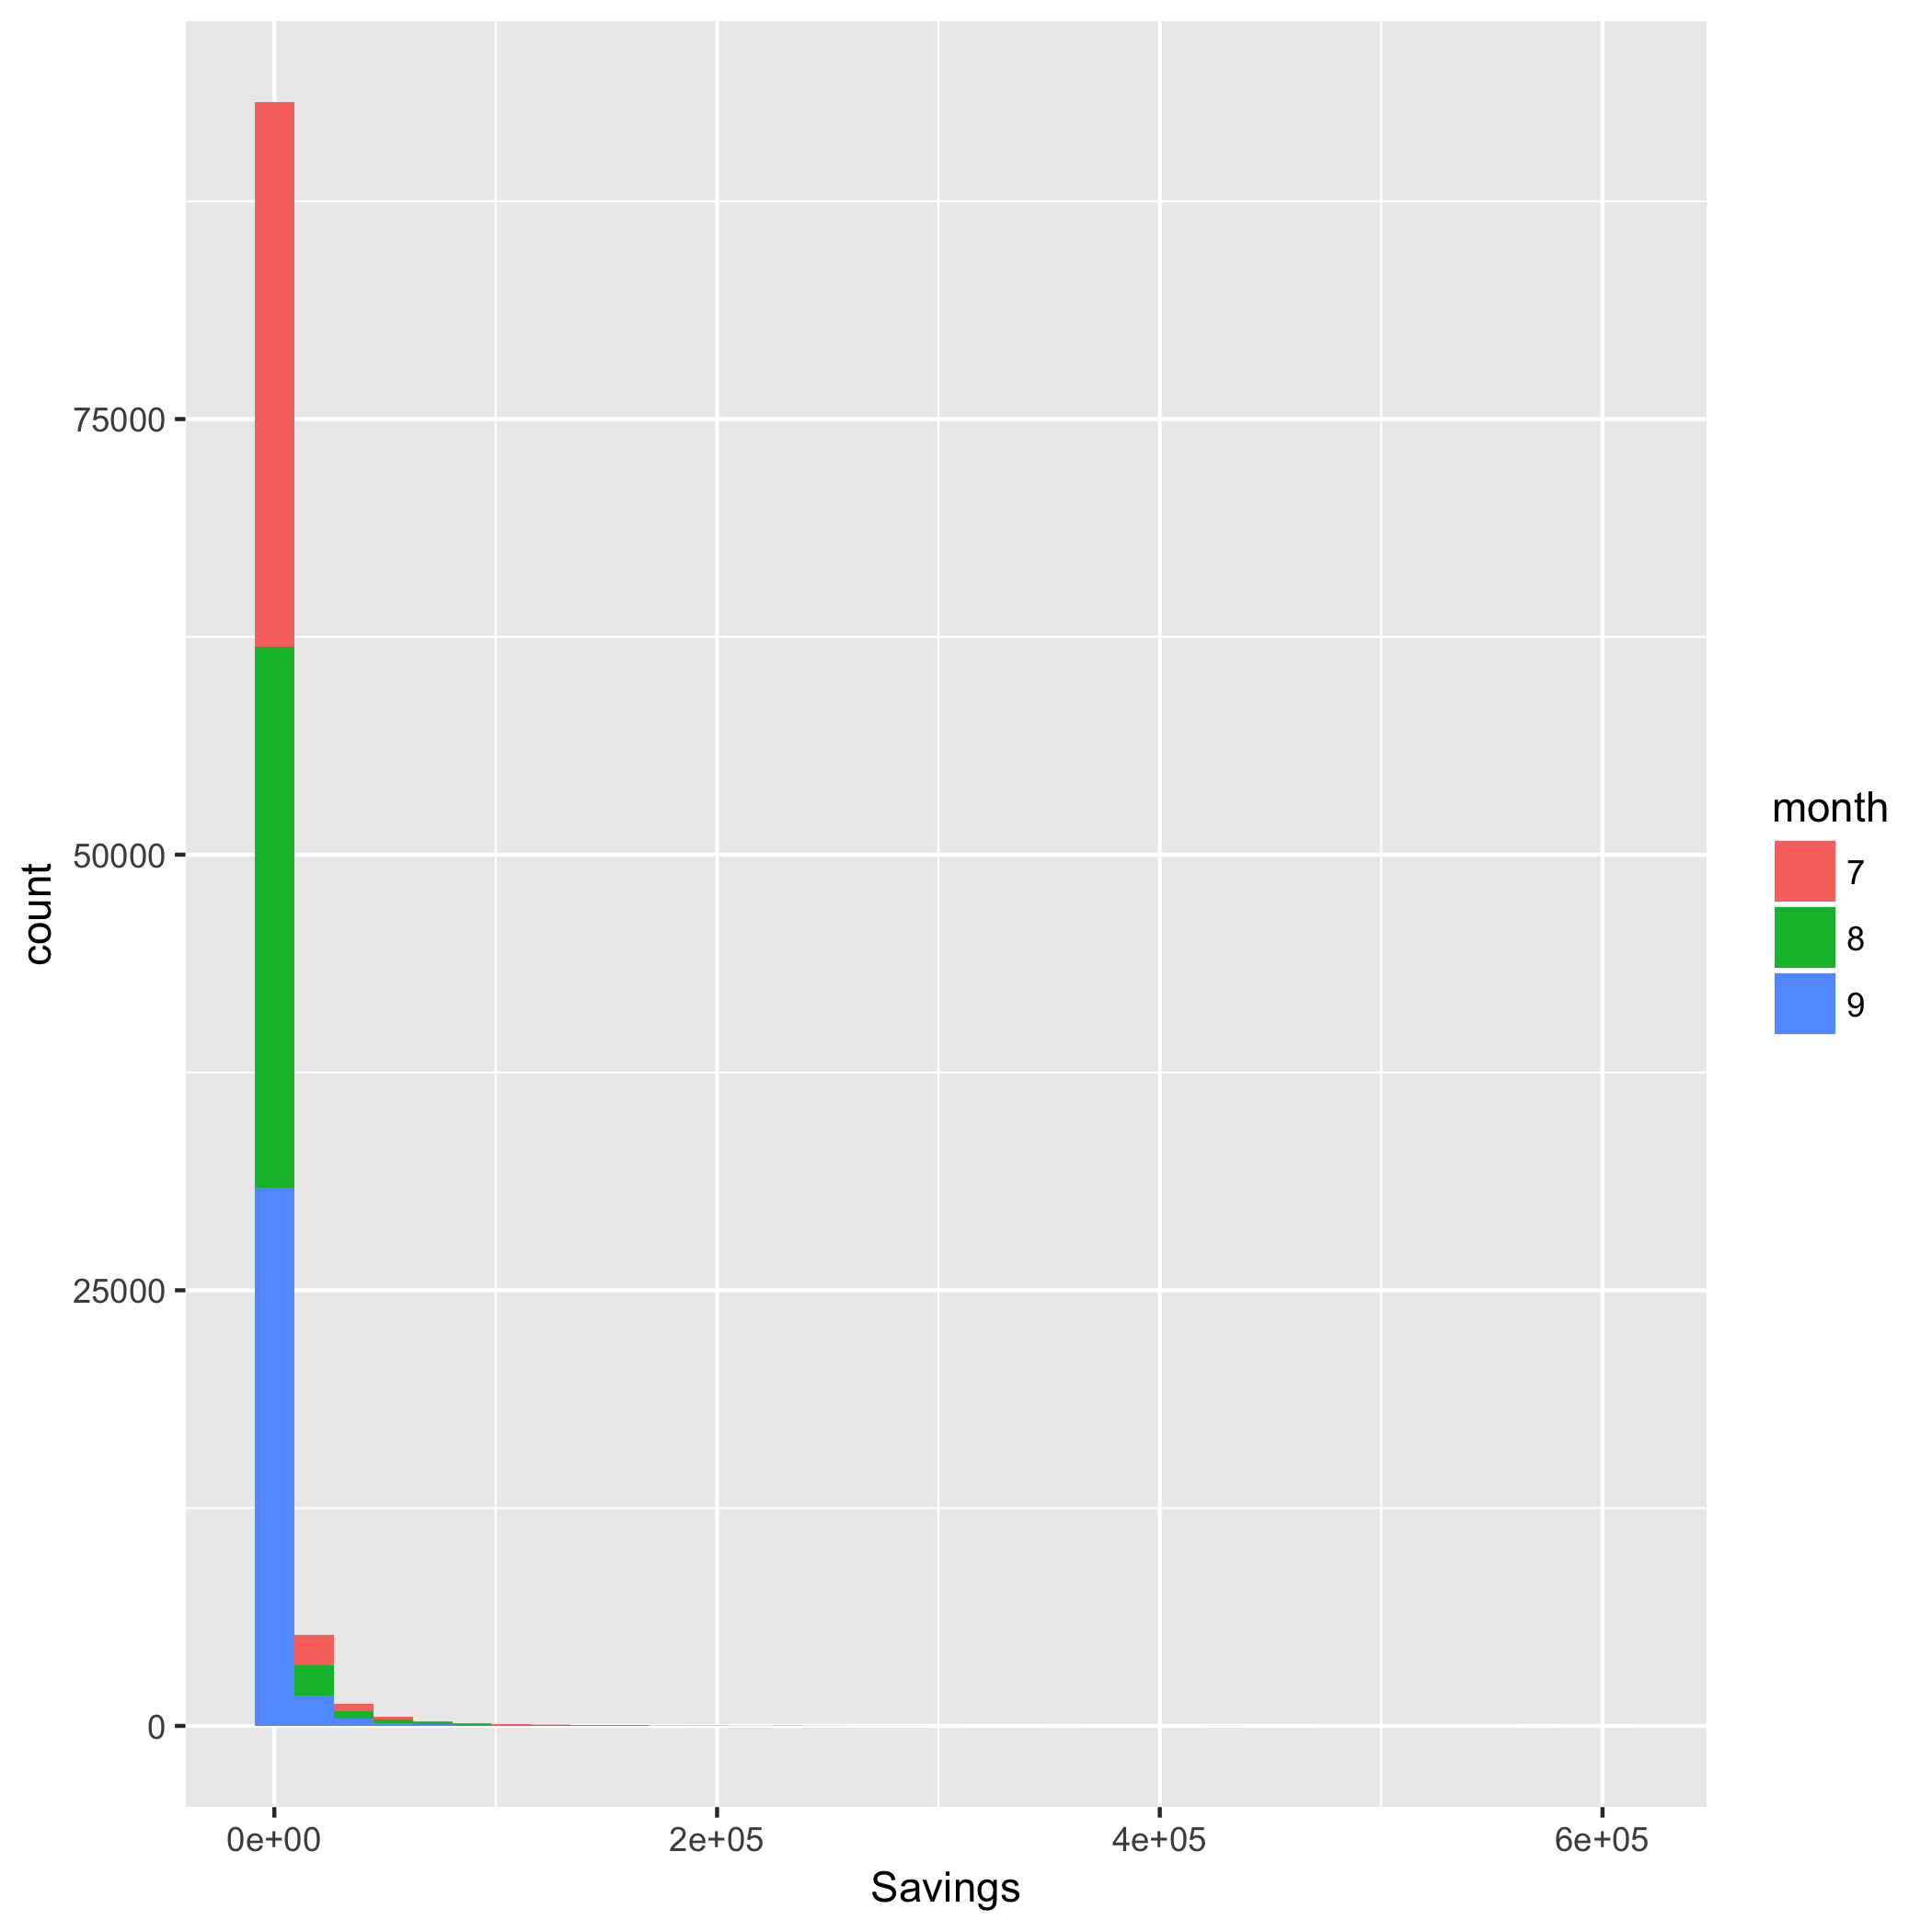
Frequency Plot:
Savings Account

Slide 14
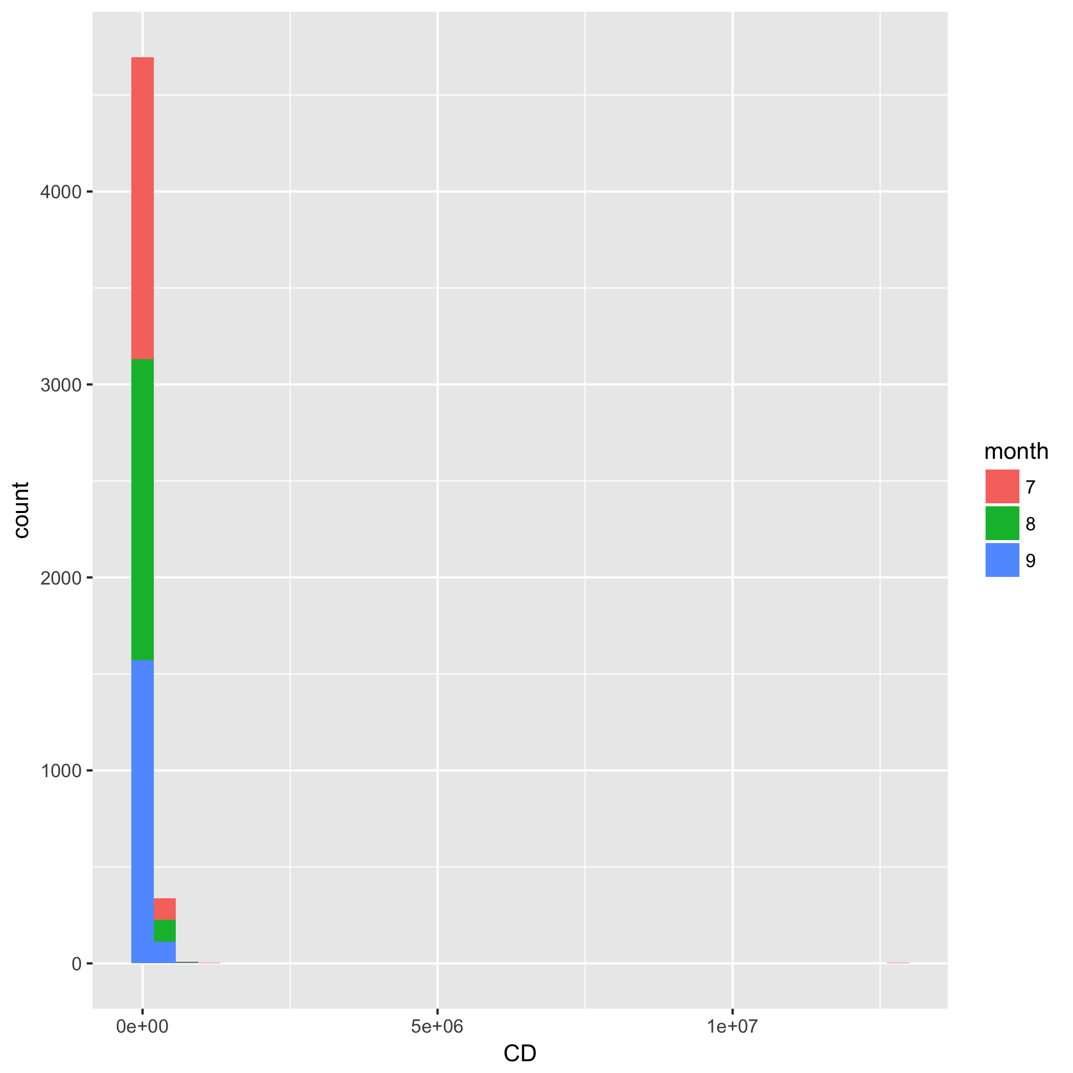
Frequency Plot:
Certificate of Deposit

Slide 15
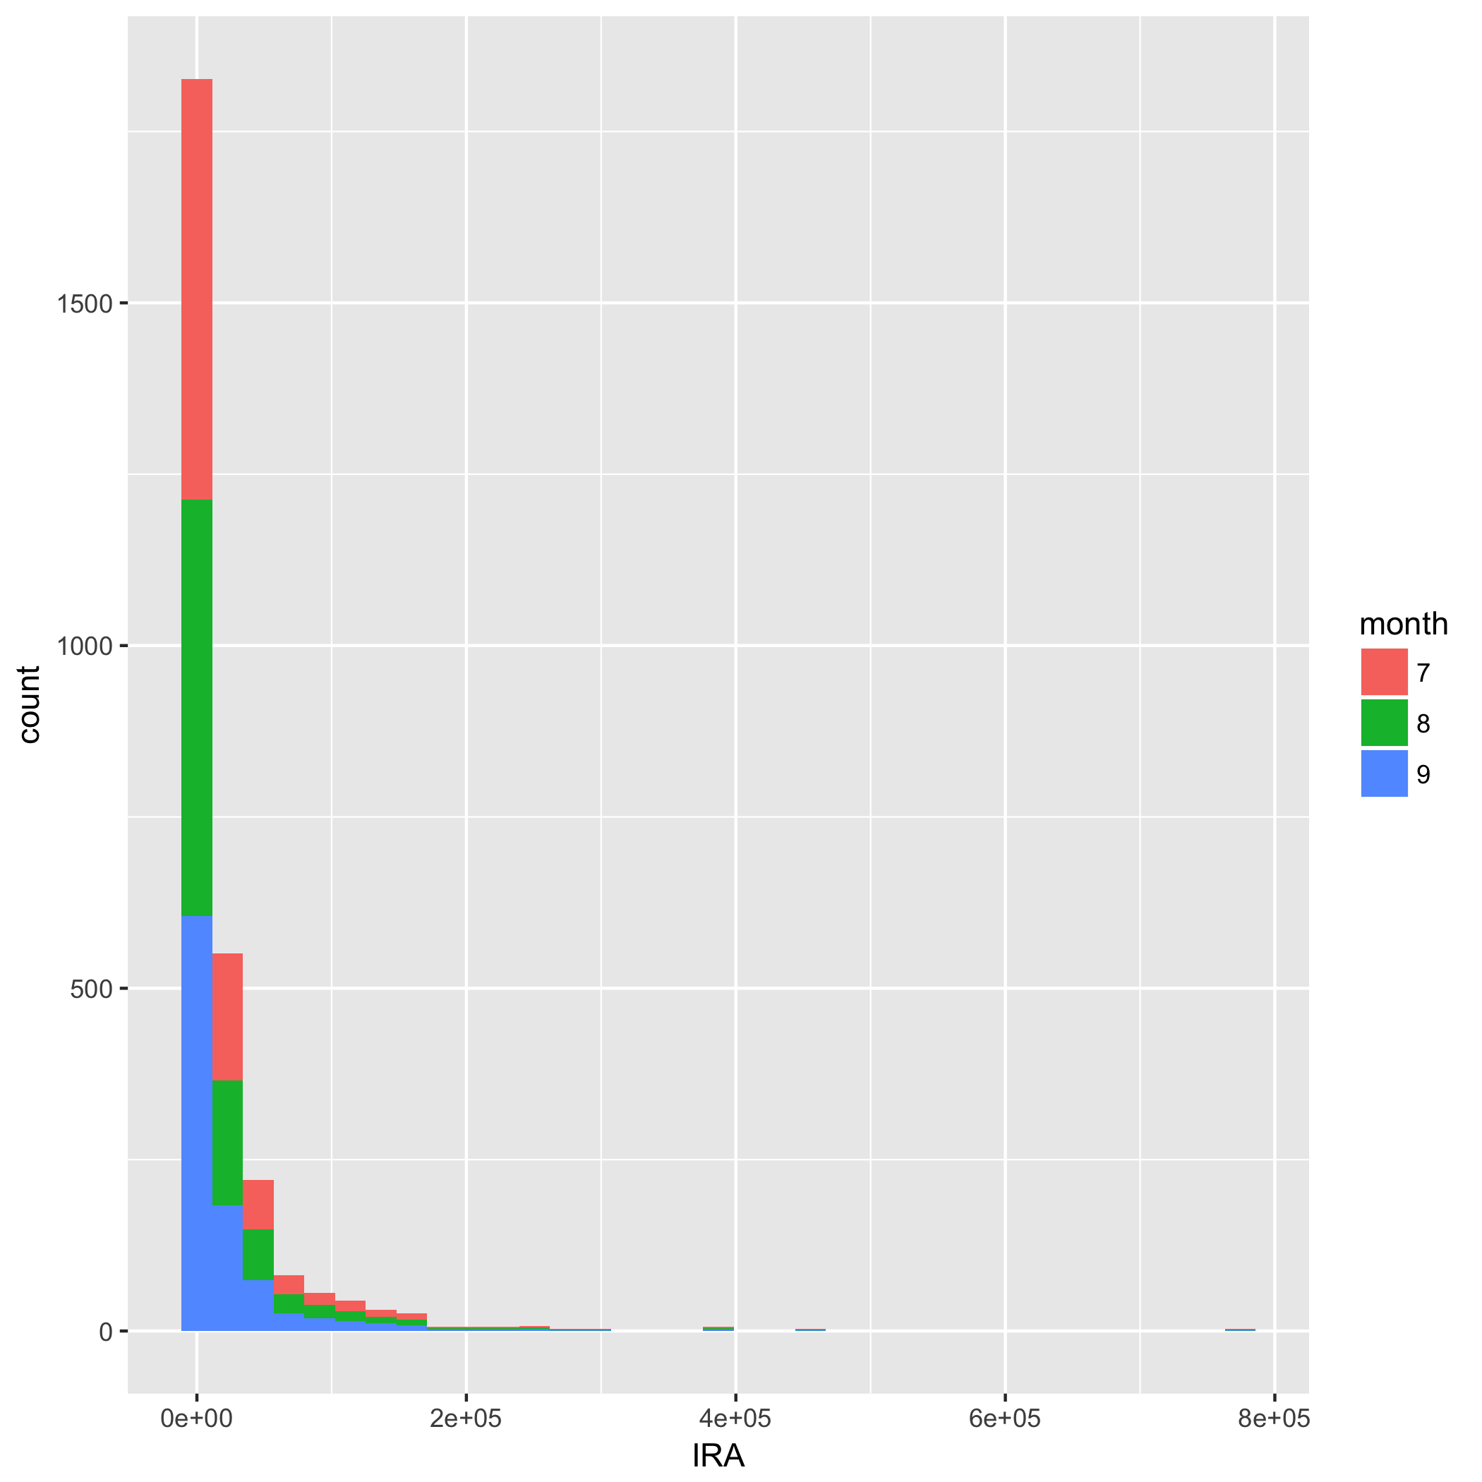
Frequency Plot:
IRA Account

Slide 16
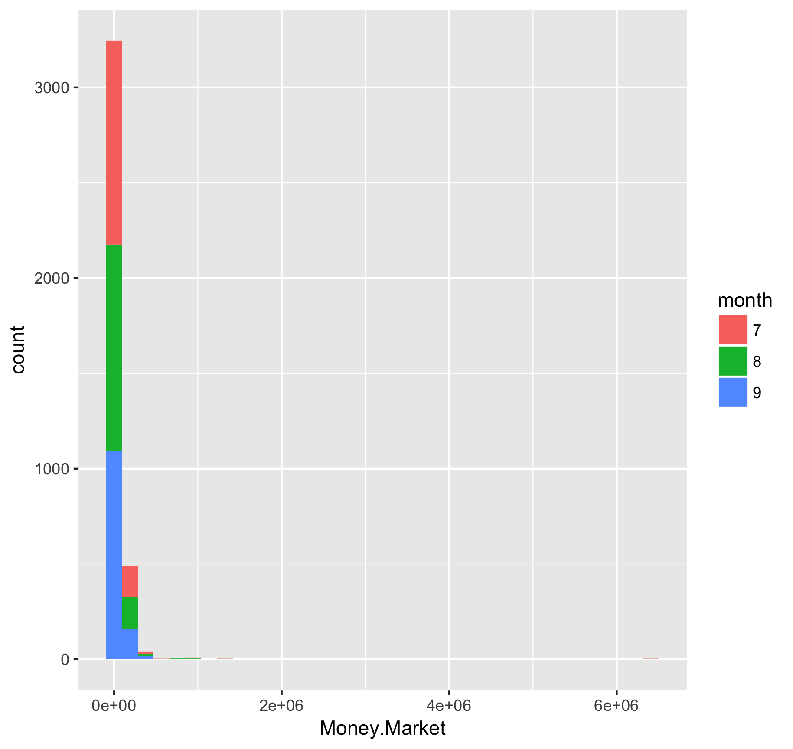
Frequency Plot:
Money Market

Slide 17
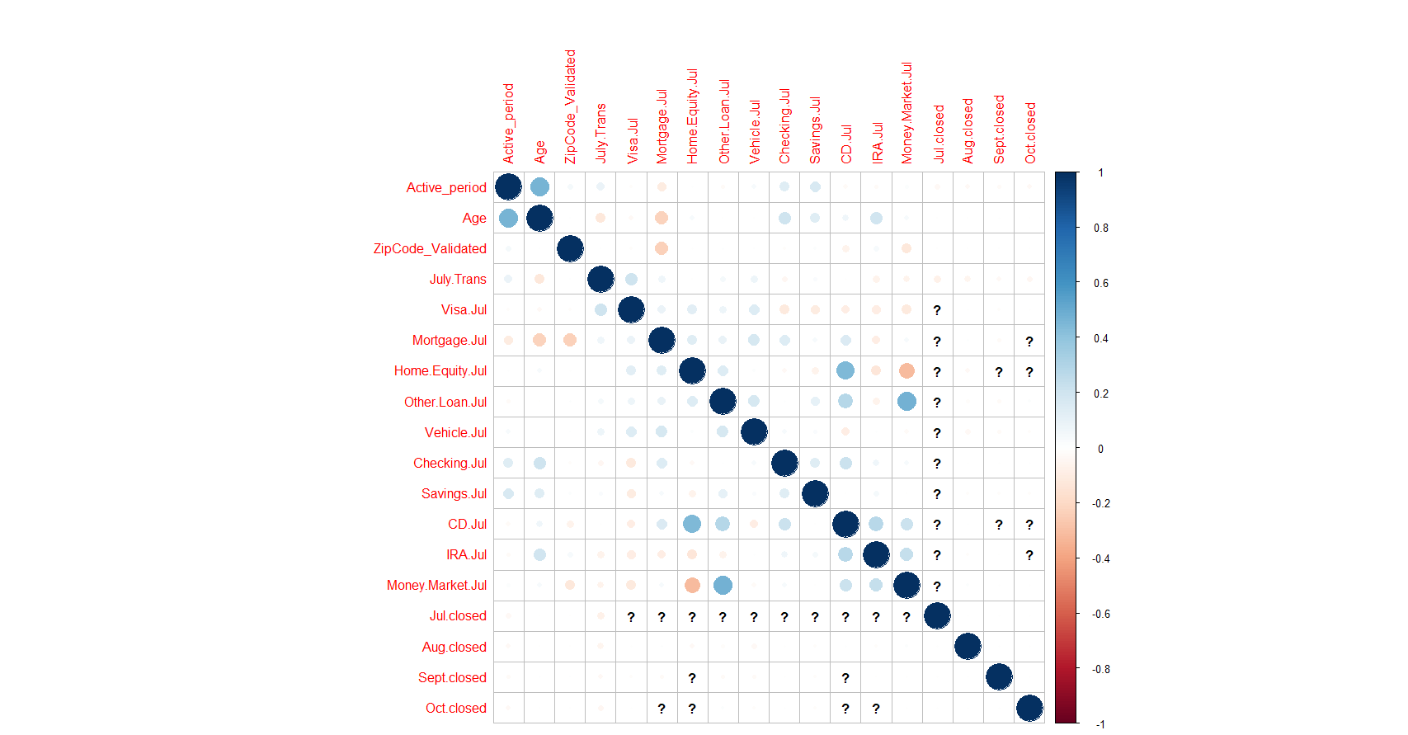
Correlation Matrix: July Accounts

Slide 18
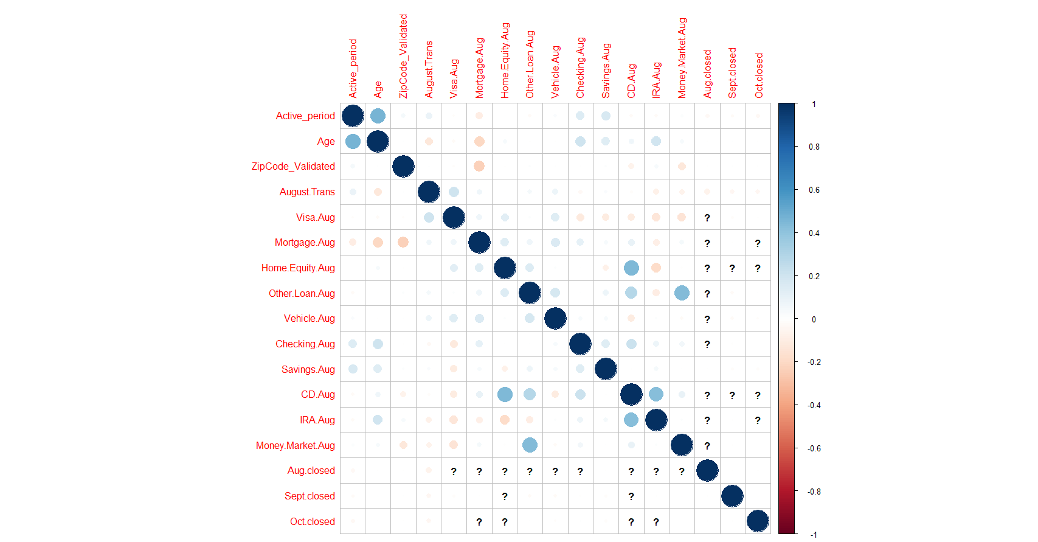
Correlation Matrix: August Accounts

Slide 19
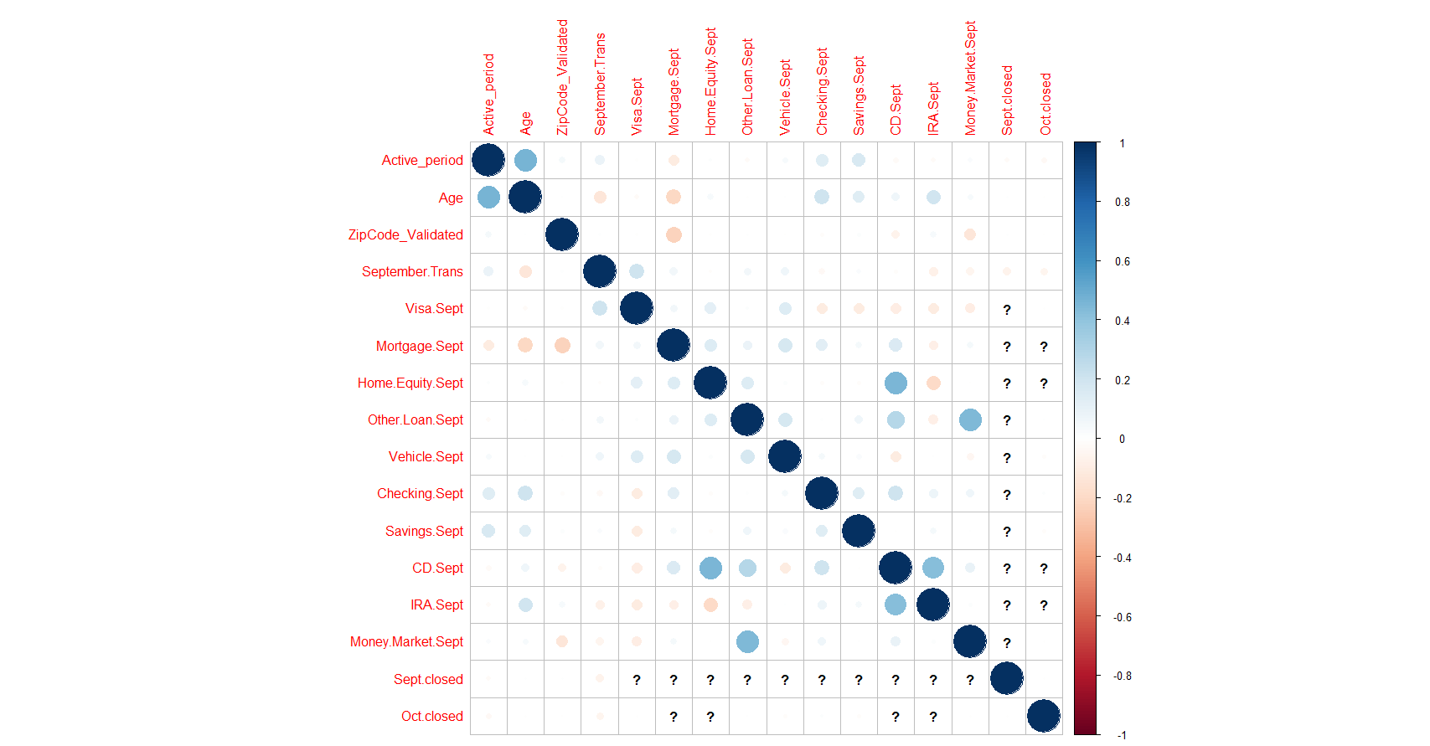
Correlation Matrix: September Accounts

Slide 20
Problems
Need high Degree between independent variables and dependent variables.
Need low degree between dependent variables.
Multicollinearity:
Age and Active Period (in days)
CD and Home Equity (in July, Aug and Sept)
Money Market and Other Loans
CD and IRA

Slide 21
Contributions
Xinzhe Deng made all the Correlation Matrices for three months of the accounts.
Han Li did additional data cleanings after we received the feedback our Data Cleaning presentation.
Lan Li created all the frequency plots based on the account informations provided.
Te Lin explored charts, gave interpretations of the plots, and raised questions for future analysis.

Slide 22
References
Wickham, H., & Grolemund, G. (2017). R for data science. OReilly.

